Slide 1
Introduction to data warehousing
MTN.BI.07
Basic Parallel Execution
Elias Nema
Lead Software Engineer
Elias_Nema@epam.com

Slide 2
Agenda
Parallel Execution
Parallel Query
Parallel DML
Parallel DDL
Partitioning + Parallel Execution = Performance Increasing

Slide 3
Parallel execution

Slide 4
Parallel Execution Theory
Scaling linearly is the ultimate goal of parallel processing (If you allocate twice the number of resources and achieve a processing time that is half of what it was with the original amount of resources)
… but …
At first we need to have enough work and divide it somehow (even distribution is desired)

Slide 5

Parallel Execution
The application of multiple CPU and I/O resources to the execution of a single database operation.

Slide 6
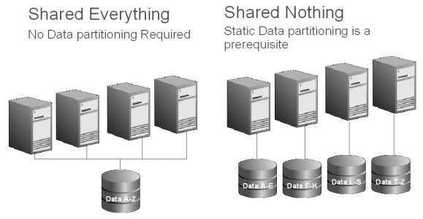
Shared Everything vs. Share Nothing

Slide 7
The Oracle Way
Most non-Oracle data warehouse systems are shared nothing systems.
Oracle Database relies on a shared everything architecture. This architecture does not require any pre-defined data partitioning to enable parallelism; however by using Partitioning, Oracle can deliver the exact same parallel processing capabilities as a shared nothing system.

Slide 8
SQL Statement Execution
Each SQL statement undergoes an optimization and parallelization process when it is parsed…
Create cursor (a cursor exists for every statement run)
Parse statement (hard or soft)
Describe results and define output (Queries only) used to determine and define what the result set looks like (datatypes, etc)
Bind variables
Parallelize statement (optional)
Run
Fetch rows (Queries only)
Close cursor

Slide 9
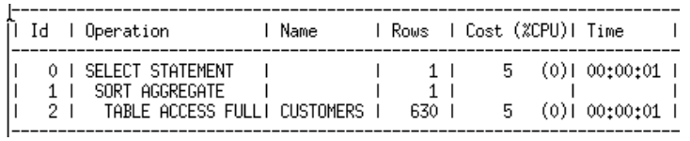
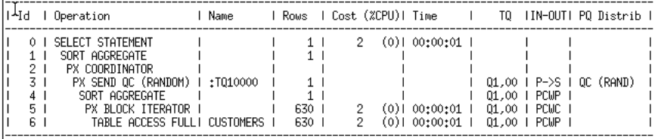
Serial and Parallel Plans

Slide 10
Roles
SQL parallel execution in the Oracle is based on the principles of a coordinator (often called the Query Coordinator – QC for short) and parallel execution (PX) server processes.
QC:
is the session that initiates the parallel SQL statement (it parses the query and sends to PX)
allocates PXs and distributes the work to them
may have to perform a minimal portion of the work and sending output to user
PX:
are the individual sessions that perform work in parallel

Slide 11
But where to get all these workers?
When an instance starts up, Oracle Database creates a pool of parallel execution servers which are available for any parallel operation. A process called the parallel execution coordinator dispatches the execution of a pool of parallel execution servers and coordinates the sending of results from all of these parallel execution servers back to the user.
The parallel execution servers are enabled by default, because by default the value for PARALLEL_MIN_SERVERS initialization parameter is set >0.

Slide 12
Parallel Execution
When user initiates a parallel SQL statement background process becomes QC & it will distribute the work to parallel servers
Parallel servers communicate among themselves & the QC using messages that are passed via memory buffers in the shared pool
Parallel servers - individual sessions that perform work in parallel. They are allocated from a pool of globally available parallel server processes and assigned to a given operation
Parallel server connections
Messages
QC connections
Notes:
The user session takes on the role of a coordinator.
The query coordinator obtains the necessary number of parallel servers.
The SQL statement is executed as a sequence of operations. The parallel execution servers performs each operation in parallel if possible.
When the parallel servers are finished executing the statement, the query coordinator performs any portion of the work that cannot be executed in parallel. For example, a parallel query with a SUM() operation requires adding the individual subtotals calculated by each parallel server.
Finally, the query coordinator returns any results to the user.

Slide 13
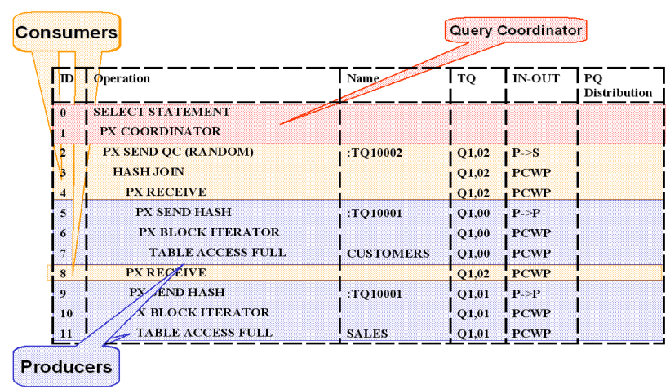
Producer/Consumer Model
In order to execute a statement in parallel efficiently sets of PX servers work in pairs: one set is producing rows (producer) and one set is consuming the rows (consumer).

Slide 14
How Parallel Execution Works
Hash join always begins with a scan of the smaller table. In this case that’s is the customer table. The 4 producers scan the customer table and send the resulting rows to the consumers
Query coordinator
P1
P2
P3
P4
Consumers
SALES
Table
P5
CUSTOMERS
Table
P6
P7
P8
Producers

Slide 15
How Parallel Execution Works
Once the 4 producers finish scanning the customer table, they start to scan the Sales table and send the resulting rows to the consumers
Query coordinator
P1
P2
P3
P4
Consumers
SALES
Table
P5
CUSTOMERS
Table
P6
P7
P8
Producers

Slide 16
How Parallel Execution Works
Once the consumers receive the rows from the sales table they begin to do the join. Once completed they return the results to the QC
Query coordinator
P1
P2
P3
P4
Consumers
SALES
Table
P5
CUSTOMERS
Table
P6
P7
P8
Producers

Slide 17
Granules
Oracle database uses a shared everything architecture, which from a storage perspective means that any CPU core in a configuration can access any piece of data; this is the most fundamental architectural difference between Oracle and all other database vendors on the market.
Unlike all other systems, Oracle can – and will - choose this smallest unit of work solely dependent on a query's requirements.

Slide 18
Block-Based Granules
The basic mechanism the Oracle uses to distribute work for parallel execution is block ranges on disk – so-called block-based granules. This methodology is unique to Oracle and is independent of whether the underlying objects have been partitioned.
The number of granules is always much higher than the requested DOP in order to get an even distribution of work among parallel server processes.
Notes:
DOP - Degree of Parallelism

Slide 19
Partition-Based Granules
With partition-based granules only one PX server performs the work for all data in a single partition. The Oracle Optimizer considers partition-based granules if the number of (sub)partitions accessed in the operation is at least equal to the DOP (and ideally much higher).
The most common operations that use partition-based granules are partition-wise joins.

Slide 20
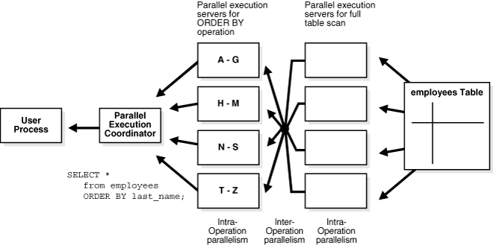
Intra/Inter-Operation Parallelism

Slide 21
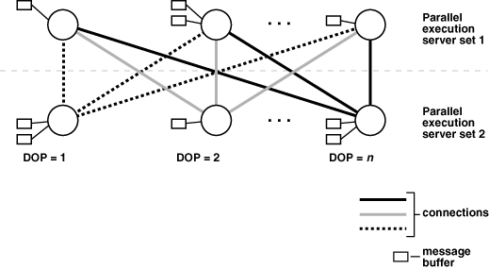
Parallel Execution Server Connections and Buffers
The producer server retrieves rows from tables and the consumer server performs operations such as join, sort, DML, and DDL on these rows.
Servers communicate by passing the buffers back and forth in memory (in the shared pool).

Slide 22
Parallel query/ddl/dml

Slide 23
Types of Parallel Execution
Parallel query: performing a single query using many operating system processes or threads. Oracle will find operations it can perform in parallel, such as full table scans or large sorts, and create a query plan that does them in parallel.
Parallel DML (PDML): This is very similar in nature to parallel query, but it is used in reference to performing modifications (INSERT, UPDATE, DELETE, and MERGE) using parallel processing.
Parallel DDL: Parallel DDL is the ability of Oracle to perform large DDL operations in parallel.
Procedural parallelism: This is the ability to run developed code in parallel.

Slide 24
Partitioning + Parallel Execution

Slide 25
Partition-Wise Joins
Partition-wise joins can be applied when two tables are being joined and both tables are partitioned on the join key, or when a reference partitioned table is joined with its parent table. Partition-wise joins break a large join into smaller joins that occur between each of the partitions, completing the overall join in less time.
Partition-wise joins reduce query response time by minimizing the amount of data exchanged among parallel execution servers when joins execute in parallel.

Slide 26
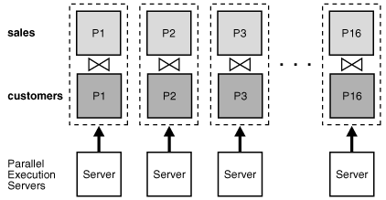
Full Partition-wise Join in Parallel

Slide 27
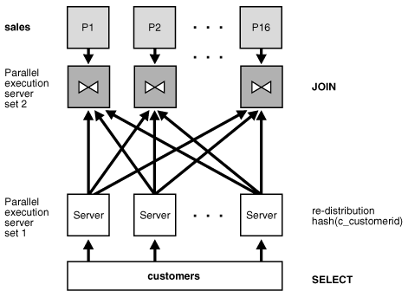
Partial Partition-Wise Join in Parallel

Slide 28
Basic Parallel Execution
Elias Nema
Lead Software Engineer
Elias_Nema@epam.com

